Slide 1
DATA MIGRATION OF EXISTING TAX PAYER
All existing taxpayers will be given a provisional ID and a password.
To enrol with the GST Common Portal, you need to perform the following steps:
1. Access the www.gst.gov.in URL. The GST Home page is displayed.
2. Click the NEW USER LOGIN button.

Slide 2
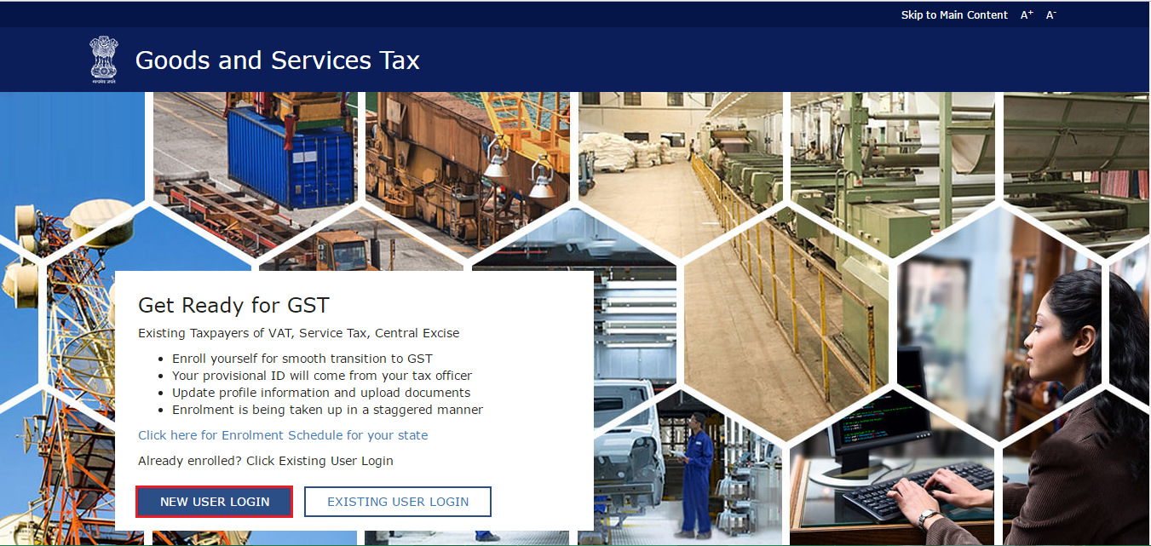

Slide 3
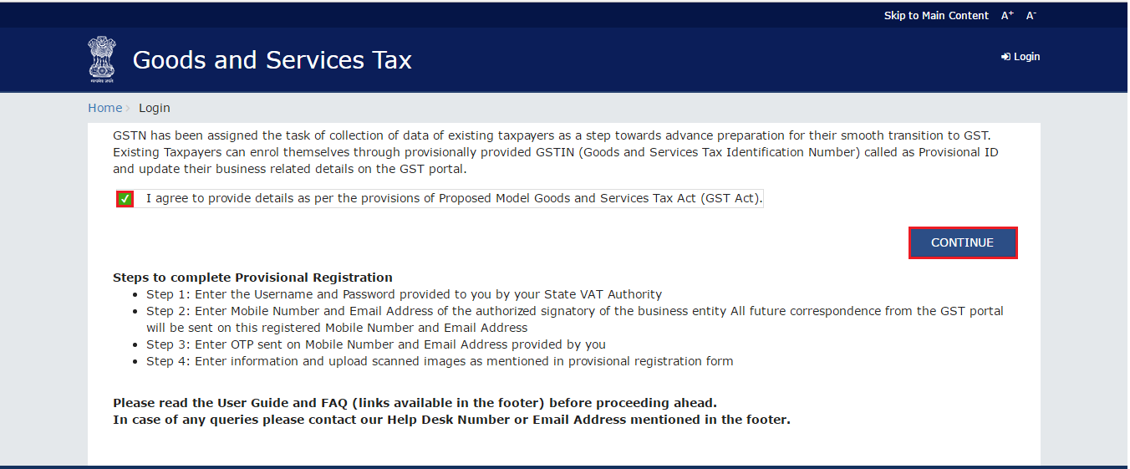
The Declaration page is displayed. Select the checkbox for declaration and click the CONTINUE button.

Slide 4
The Login page is displayed
In the Provisional ID field, type the username that you received in the e-mail, SMS or any other communication received from the State VAT Department.
In the Password field, type the password that you received in the e-mail, SMS or any other communication received from the State VAT Department.
In the Type the characters you see in the image below field, type the captcha text as shown in the screen.
Click the LOGIN button.

Slide 5
Enter Provisional ID
Enter PASSWORD
Enter CAPCHA as below
Press LOGIN

Slide 6
The Provisional ID Verification page is displayed.
In the E-mail Address field, enter your e-mail address.
In the Mobile Number field, enter your valid Indian mobile number.
Note:
Enter your own e-mail address and mobile number if you are the Primary Authorized Signatory.
All future correspondences from the GST Common Portal will be sent on this registered e-mail address and mobile number only.
E-mail address and mobile number cannot be changed till 01/04/2017.
Any change in the registered e-mail address and mobile number can be done through the amendment process after 01/04/2017 as specified in the GST Act.
Click the CONTINUE button.

Slide 7
Enter Email Address
Enter Mobile Number
Press CONTINUE

Slide 8
Two One Time Passwords (OTPs) will be sent to your e-mail address and mobile number you just mentioned.
Both OTPs are required for the verification.
Note:
You must have received two different OTPs.
Do not share these OTPs with anyone.
Check your e-mail address and note your e-mail OTP.
Also check text message sent on your mobile phone and note your mobile OTP.
The OTP Verification page is displayed.
In the Email OTP field, enter the OTP you received in your e-mail address.
In the Mobile OTP field, enter the OTP you received on your mobile phone.

Slide 9
Note:
In case you have not received the OTP, click the RESEND OTP button to resend the OTP to your e-mail address and mobile number. Both new OTPs have to be used for the verification. The validity period of OTP is 10 minutes.
Click the CONTINUE button.
Enter Email OTP
Enter Mobile OTP
Press CONTINUE

Slide 10
Note:
Username & Password should be of 8 to 15 characters, which should comprise of alphabets, numbers and can contain special character (dot (.), underscore (_) or hyphen (-)).
The New Credentials page is displayed.
Dealer need to create their username and password of their choice, which can henceforth be utilized by them

Slide 11
Enter User Name of your choice
Enter PASSWORD of your choice
Re-Enter PASSWORD
Click CONTINUE

Slide 12
The Security Questions page is displayed. For each security question, enter the answers.
Note:
There are five questions on this page. It is mandatory to enter answers to all the security questions. Be careful when answering the security questions. In case you forget your password, you will be required to answer these security questions to retrieve your password.
Click the SUBMIT button.
Enter SECURITY ANSWER
Enter SECURITY ANSWER
Enter SECURITY ANSWER
Enter SECURITY ANSWER
Enter SECURITY ANSWER
Click SUBMIT

Slide 13
The message “Username and password have been successfully changed. Kindly login using these credentials” is displayed. You can now login to the GST Common Portal using the username and password you just created.
Enter USER NAME
Enter PASSWORD
CLICK LOGIN

Slide 14
The Welcome page is displayed.
Click the CONTINUE button.
CLICK CONTINUE

Slide 15
Your Dashboard is displayed.
Note:
Enrolment application can be filled only in English language. You can save and retrieve the application later. All the fields marked with red dot are mandatory to be filled.
Alternatively, you can the click the Dashboard > Provisional ID Enrolment command to access the Enrolment Application.
On the top of the page, there are eight tabs as
Business Details, Promoter/Partners, Authorized Signatory, Principal Place of Business, Additional Place of Business, Goods & Services, Bank Accounts and Verification. Click each tab to enter the details.

Slide 16
Business Details: The Business Details tab is selected by default. This tab displays the information to be filled for the business details required for enrolment.

Slide 17
Following details are auto-populated in the enrolment application based on your existing data in VAT system but you cannot edit these details:
Legal Name of Business (as per PAN)
Legal Name of Business (as per current tax Act)
PAN of the Business
State
Ward/Circle/Sector
The Trade Name is pre-populated but you can edit the same.
a. In the Trade Name field, enter the trade name of your business.
b. In the Constitution of Business drop-down list, select the type of constitution of your business.
c. In the Ward/Circle/Sector No. drop-down list, select the Circle name of your business.
d. Under the Please indicate existing registration section, in the Registration Type drop-down list, select the appropriate registration type.
e. In the Registration No. field, enter the registration number
f. Select the Date of Registration using the calendar.
g. Click the Add button.
h. In the Document Upload section, in the Proof of Constitution of Business drop-down list, select the appropriate document to be uploaded.
i. Click the Choose File button. Navigate and select the document.
j. Click the SAVE & CONTINUE button.

Slide 18
Promoter/ Partners Details: This tab page displays the details of the stakeholders chosen in the Constitution of Business detail.

Slide 19
Promoter/ Partners Details: ... Continue....

Slide 20
Authorised Signatory Details: This tab page displays the details of the authorized signatory.

Slide 21
Authorised Signatory Details ... Continue ....

Slide 22
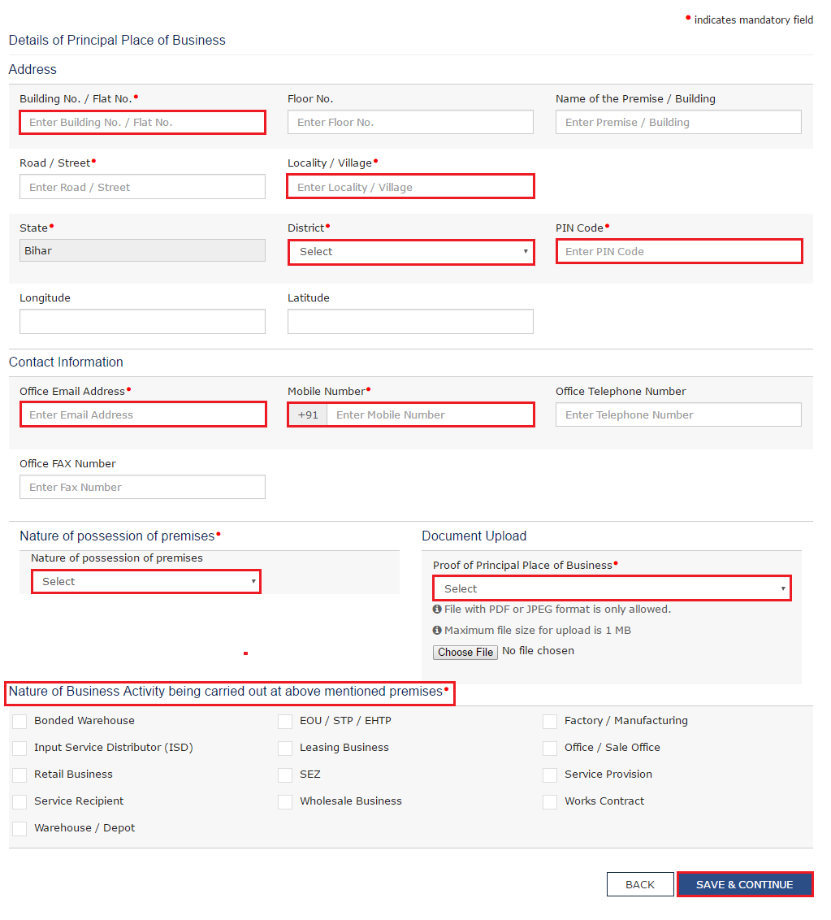
Principal Place of Business Details: This tab page displays the details of the principal place of business.

Slide 23
Principal Place of Business Details ... Continue ....

Slide 24
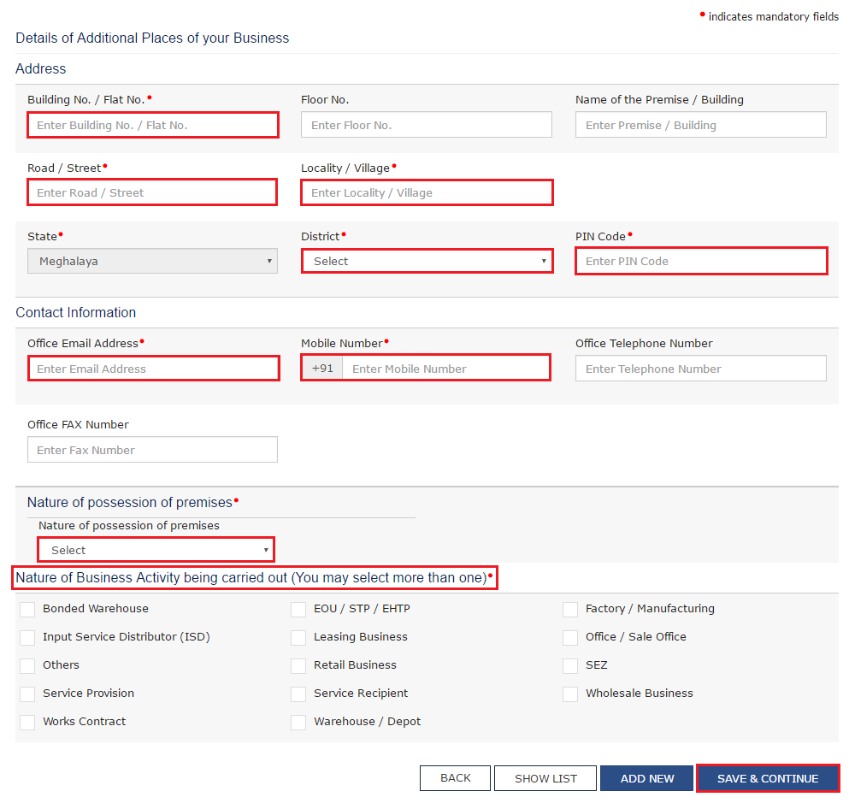
Additional Place of Business Details: This tab page displays the details of the additional places of the business. Enter the details similarly like Principal Place of Business Details provided above.

Slide 25
Goods & Services Details: This tab page displays the details of the goods and services supplied by the business. In case of Goods a. In the Search HSN Chapter by Name or Code field, enter the name or the HSN Code of the goods supplied by the business. Alternatively, you can also enter the HSN Code in the Search HSN Code field. b. Click the SAVE & CONTINUE button In case of Services a. In the Search by Name or Code field, enter the name or the SAC Code of the services supplied by the business. b. Click the SAVE & CONTINUE button.

Slide 26
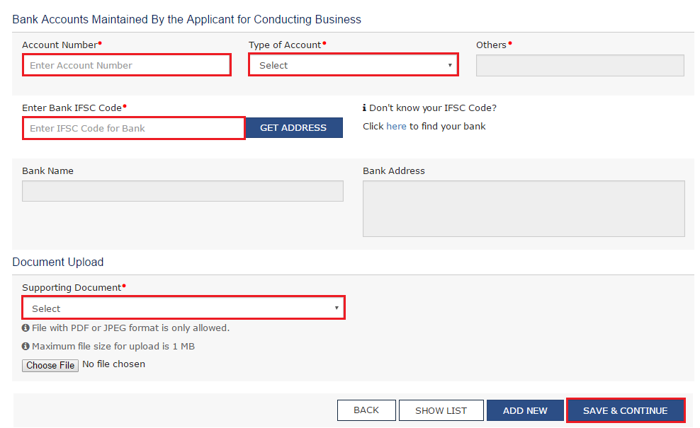
Bank Account Details: This tab page displays the details of the bank accounts maintained for conducting business.

Slide 27
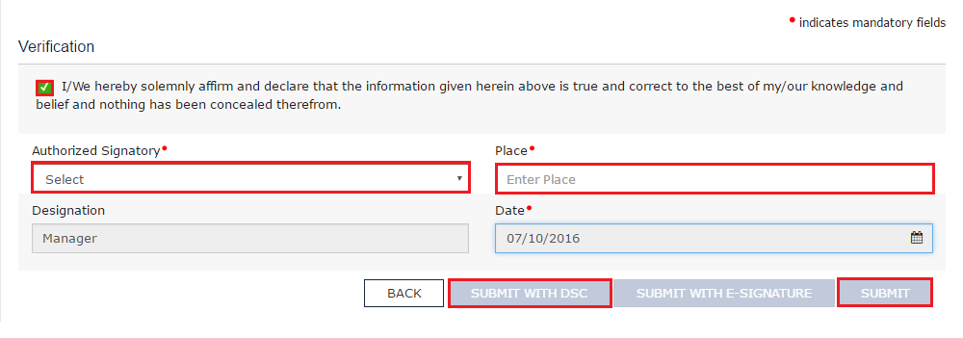
Verification: This tab page displays the details of the verification for authentication of the details submitted in the form. a. Select the Verification checkbox. b. In the Authorized Signatory drop-down list, select the name of the authorized signatory. c. In the Place field, enter the place of your principal place of business. d. After filling the enrolment application, you need to digitally sign the application using Digital Signature Certificate (DSC) or E-Signature. Note: In case, your DSC is not registered, you will need to register DSC. Click here to know more about how to register DSC. e. Click the SUBMIT WITH DSC button.

Slide 28
Note: To save the Enrolment Application, click the SUBMIT button. Click here to know more about how to access saved Enrolment Application and edit it.

Slide 29
Click the PROCEED button. Select the certificate and click the SIGN button. The success message is displayed. You will receive the acknowledgement in next 15 minutes on your registered e-mail address and mobile number. Application Reference Number (ARN) receipt is sent on your e-mail address and mobile number. Submission of application with the details is NOT completed unless DSC is affixed.

Slide 30
Thank you

